Slide 1
N-body problem

Slide 2
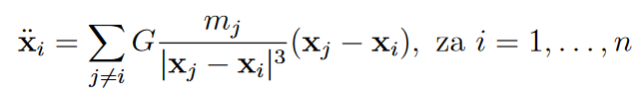
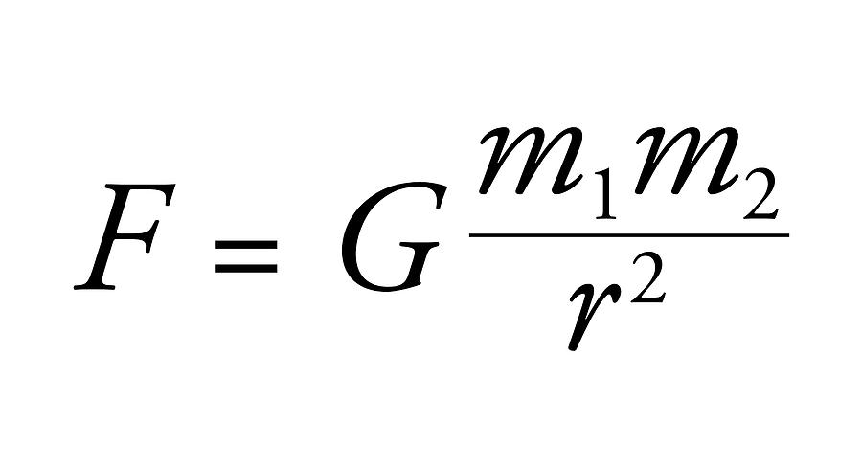
Problem description
Euler‘s method:
x = v *dt
v = a * dt
The problematic part:
O(n^2)
a1 = F / m1

Slide 3

Python starting implementation
50 bodies in real time.
The real time rendering is done by the CPU, which slows it down greatly.

Slide 4
Julia implementation
2000 steps:
13 sec, 100 bodies, 6.5 ms / step
30 sec, 200 bodies, 15 ms / step
6 min, 800 bodies, 180 ms / step
25 min, 1400 bodies, 750 ms / step

Slide 5
Unity
C#
Rendering done by the GPU
Basic implementation – 200 bodies in real time
Partial step skipping – 500 bodies in real time

Slide 6
Unity Compute Shader implementation
Shader written in HLSL (High Level Shader Language)
Computation done by the GPU – parallelism
5000 bodies in real time, without a problem
Data -> compute buffer
Compute buffer -> compute shader
Changes the data in place
Compute buffer -> data

Slide 7
Added features
Colors – the more red the colour, the faster the body is relative to others.
Collisions – if two objects come close enough, they merge (problematic, O(n^2) )
Scaling – the more mass it has, the bigger it appears.

Slide 8
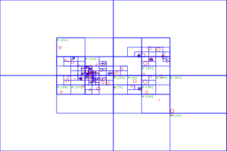
Alternative: Barnes-Hut algorithm – O(nlogn)

Slide 9
Examples
Example generation

